Slide 1
Loan Status Prediction
Yash Titare

Slide 2
Problem Statement
The data preprocessing stage extracts useful information statistically. Such as checking
outliers, and skewness, comparing the features by graph, and many more.
Predict the Loan Status .
Key features :
1. Identify the relationships in dataset .
2. Analysis on applications received .
3. Other attributes like dependencies, employed are important factors, etc.

Slide 3
Proposed Solution
Data Preprocessing.
2.Calculate Statistics.
3 .Correlation Analysis.
4. This conclusion to provided dataset to extract valuable insights for dataset.

Slide 4

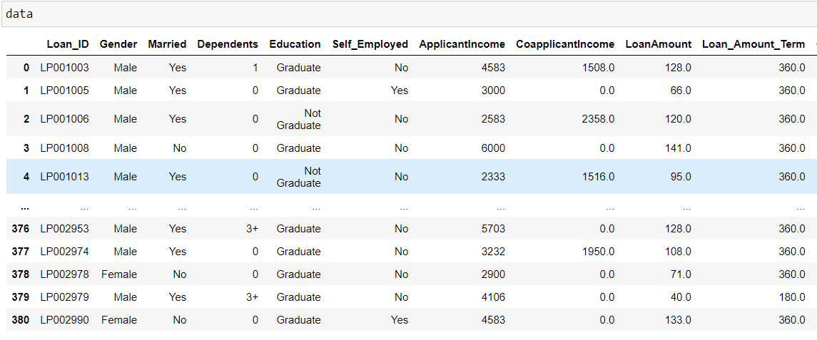
Descriptive Analysis

Slide 5
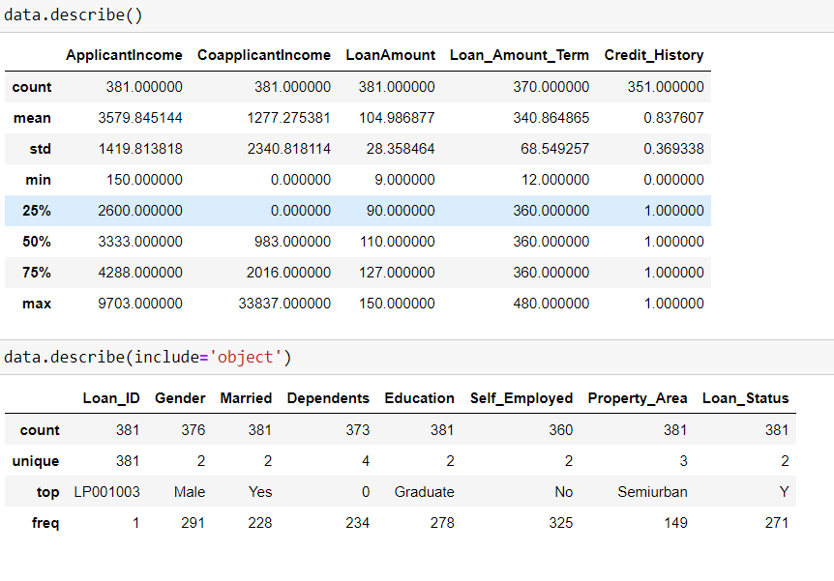
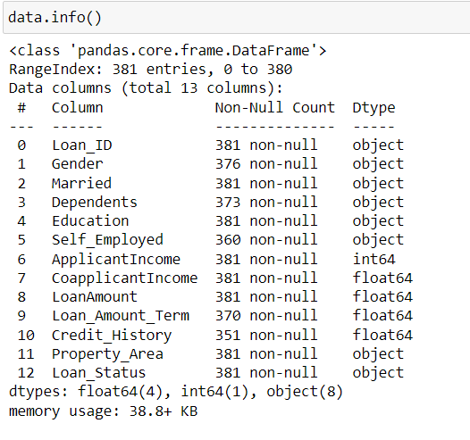

Slide 6
Effect of Data Preprocessing
Data preprocessing transforms the data into a format that is more easily and effectively processed in data mining, machine learning and other data science tasks.
Data is I structured form makes analysis easier

Slide 7
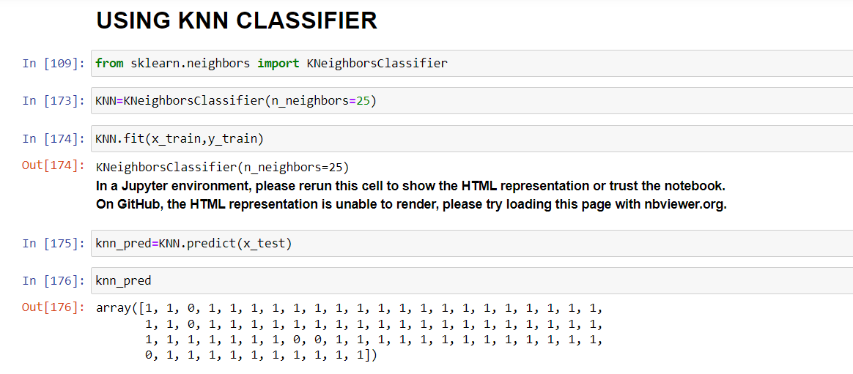
Machine Learning Modelling
To predict the loan status KNN CLASSIFIER is used for better accuracy.
After preprocessing which consist of handling null values and treating outliers I have predict the loan status.

Slide 8
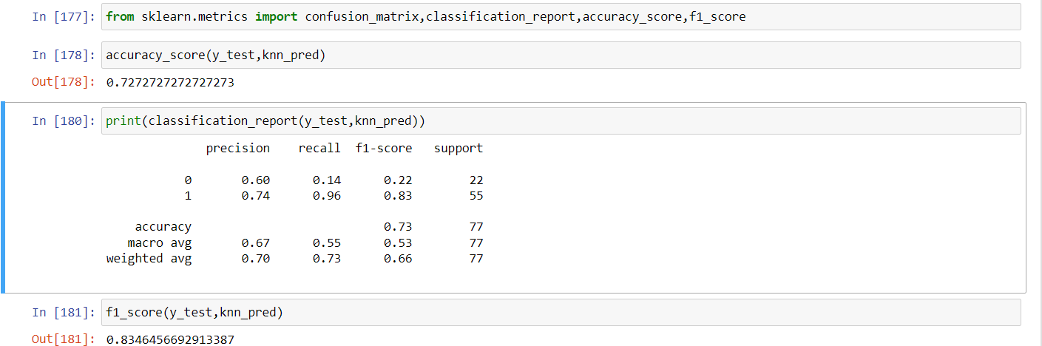
Optimisation

Slide 9
Conclusion
In summary, while an accuracy of 83% indicates a reasonably performing model, careful consideration of the implications, further optimization opportunities, and validation techniques are necessary to draw meaningful conclusions and make informed decisions.

Slide 10
Future Scope
The futuristic scope of a loan status prediction ML model
Risk Mitigation and Improved Decision Making
Fraud Detection
Automation in lending

